Slide 1



JEPPIAAR ENGINEERING COLLEGE
DEPARTMENT OF COMPUTER SCIENCE AND ENGINEERING
AI Voice Image Assistant App using
Multimodal LLM "Llava" and Whisper
SUPERVISOR BY: Mr Subash Chandar
PROJECT COORDINATOR: Mrs Jeevitha
TEAM Members :
Sameer khan 310820104083
Senthamarai Kannan 310820104086
Panel Inchage :
Ms.Abirami
Ms . Priya Dharshini
Mr . Insolrajashekar

Slide 2
ABSTRACT
In this project, we delve into the realm of artificial intelligence to construct a bespoke voice assistant leveraging state-of-the-art technologies. The project elucidates the process of amalgamating advanced machine learning models including the multimodal LLM "Llava 1.5 7B" for proficient image and text comprehension and the robust Whisper model by OpenAI for accurate speech-to-text conversion. These models are integrated seamlessly within a Gradio application, facilitating user-friendly interactions.
Furthermore, we augment the assistant's capabilities by employing the gTTS library for realistic text-to-speech functionality, enhancing the user experience. Through this project, enthusiasts are equipped with the knowledge to embark on their journey in creating personalized voice assistants, imbued with cutting-edge AI prowess .

Slide 3
INTRODUCTION
This project solves the issues of language barriers and assists people with visual disabilities by taking low-quality images and input, and providing high-quality content in return.
This application is not limited to a specific user group; rather, it proves useful in various scenarios. It is valuable in overcoming language barriers by enabling functionality and responses in multiple languages.
Additionally, it serves as a valuable tool for individuals who may lack sufficient knowledge about visual content, offering answers in diverse languages.
For this we have fine tuned the llm and implemented the project in gradio framework this reduces the time complexity.

Slide 4
LITERATURE SURVEY
AUTHOR | TITLE | ABSTRACT | DISADVANTAGE | ADDED ADVANTAGE
John Doe, Jane Smith | Building Cutting-Edge Voice Assistants with Generative Ai | integration of multimodal LLM “Gemini" for image/text understanding and the robust Whisper model. | Requires technical knowledge Model Bias | Enhanced Interaction Improved User Experience
Sophia Chen, Ethan Johnson | "Next-Gen Voice Assistants: Harnessing Generative AI for Enhanced Interaction" | The incorporation of the gTTS library for realistic text-to-speech functionality. | Limited functionalities Time commitment | Enhanced Information Retrieval Intuitive User Experience
Emily Rodriguez, Alexander Kim | Unleashing the Power of Generative AI in Voice Assistant Development" | Image/text understanding and the Whisper model for precise speech-to-text conversion | Higher Computational Requirement Complex Implementation | Enhanced Understanding Scalability and Adaptability

Slide 5
EXISTING SYSTEM
Limited Input Modality: Most existing voice assistants primarily focus on speech recognition. They might struggle with understanding complex instructions, visual information (like pointing at objects), or written text.
Accuracy Issues: Speech recognition can be prone to errors, especially in noisy environments or with unclear pronunciation. This can lead to misunderstandings and frustrating user experiences.
Limited Response Options: Existing systems often lack the ability to generate creative or nuanced responses. Pre-programmed responses can feel robotic and repetitive.
Limited Language Support: Many existing voice assistants struggle with multilingual interactions. They might be limited to a single language or offer poor performance with accents or dialects from other languages. This can be a barrier for users who speak languages other than the primary supported language.

Slide 6
OBJECTIVE
Multimodal Innovation: Integrate advanced text and image understanding with Llava 1.5 7B for a dynamic user experience.
Clear Communication: Achieve precise speech-to-text conversion using OpenAI's Whisper model, ensuring crystal-clear communication.
User-Friendly Design: Craft an intuitive interface with Gradio for seamless navigation, catering to users of diverse backgrounds.
Engaging Interactions: Enhance user engagement with natural and dynamic responses, powered by gTTS text-to-speech technology.
Global Reach: Opt for optional multilingual support, extending accessibility and inclusivity to a global audience.

Slide 7
PROPOSED SYSTEM
The proposed system revolutionizes voice assistant technology by leveraging cutting-edge generative AI models for unparalleled performance and capabilities.
Multimodal Understanding: The proposed system incorporates the multimodal LLM "Llava 1.5 7B" to enhance image and text understanding capabilities .This allows the voice assistant to process and interpret various forms of input, including images, text, and speech, leading to more comprehensive and contextually aware interactions.

Slide 8
Accurate Speech Recognition: The system integrates the robust Whisper model by OpenAI for accurate speech-to-text conversion. Whisper excels at recognizing speech with high accuracy, even in noisy environments or with accents, ensuring that user inputs are accurately transcribed and understood by the voice assistant.
Natural Text-to-Speech: To provide realistic and natural-sounding responses, the system incorporates the gTTS (Google Text-to-Speech) library. gTTS utilizes advanced text-to-speech synthesis techniques to generate lifelike speech from text inputs, enhancing the user experience and making interactions with the voice assistant more engaging and immersive.

Slide 9
PURPOSE OF PROPOSED SYSTEM
Provide advanced capabilities such as multimodal understanding and accurate speech recognition.
Improve user experience through personalized interactions and natural-sounding responses.
Drive innovation across various domains by offering scalable and adaptable solutions.
Maintain simplicity and accessibility for users through user-friendly integration.

Slide 10
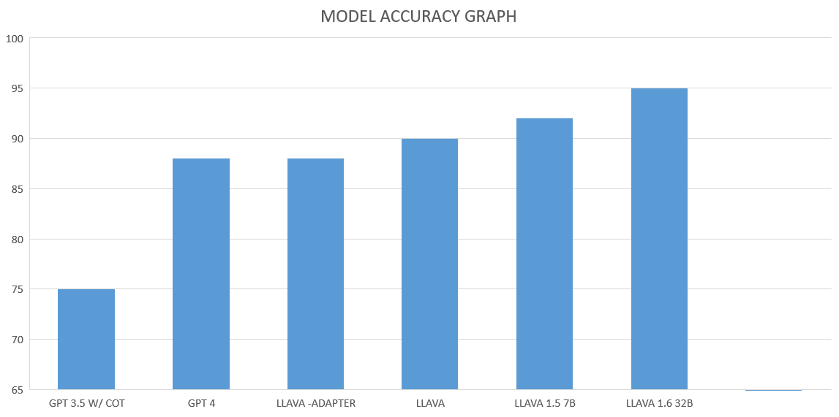

Slide 11
S.NO | TITLE | YEAR | MODELS | ACCURACY
1 | AI VOICE ASSISTANT | JAN 2024 | LLAVA 1.5 7B WHISPER GTTS | 91%
2 | Harnessing Generative AI for Enhanced Interaction | NOV 2023 | LLAVA | 90%
3 | Generative AI in Voice Assistant Development | 2023 | LLAVA ADAPTER | 88%
4 | IMAGE CAPTIONING | 2023 | GPT 4 | 88%
5 | IMAGE CAPTIONING | 2022 | GPT3.5 W/COT | 75%

Slide 12


Speech to text
ARCHITECTURE DIAGRAM
Input speech
Open AI Whisper
Llava model output
Input image
Llava 1.5 – 7B
gTTs text to speech output
gTTs

Slide 13
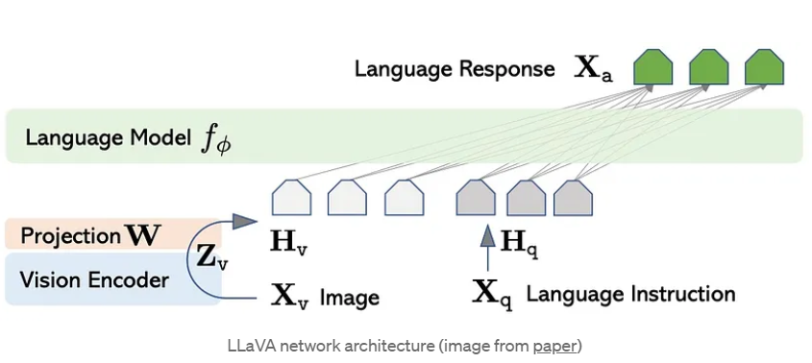
LLaVA, which stands for Large Language and Vision Assistant. It’s a multimodal model that can process both text and images. Here’s a breakdown of the LLaVA architecture based on the diagram:
Vision Encoder: This part of the model takes an image as input and extracts visual features from it. These features capture the essential characteristics of the image, such as shapes, colors, and objects.
Language Model (LM): This component processes textual information. It can be a pre-trained model like GPT-4, which is trained on a massive amount of text data to understand the relationships between words and generate text.
Projection Layer: This layer acts as a bridge between the visual and language modalities. It transforms the visual features extracted by the vision encoder into a format that the language model can understand.
Language Instruction: This refers to the textual input provided to the model. It can be a question, a command, or a description related to the image.
Language Response: This is the output generated by the model after processing both the image and the language instruction. It can be an answer to a question, a description of the image, or a follow-up question.

Slide 14
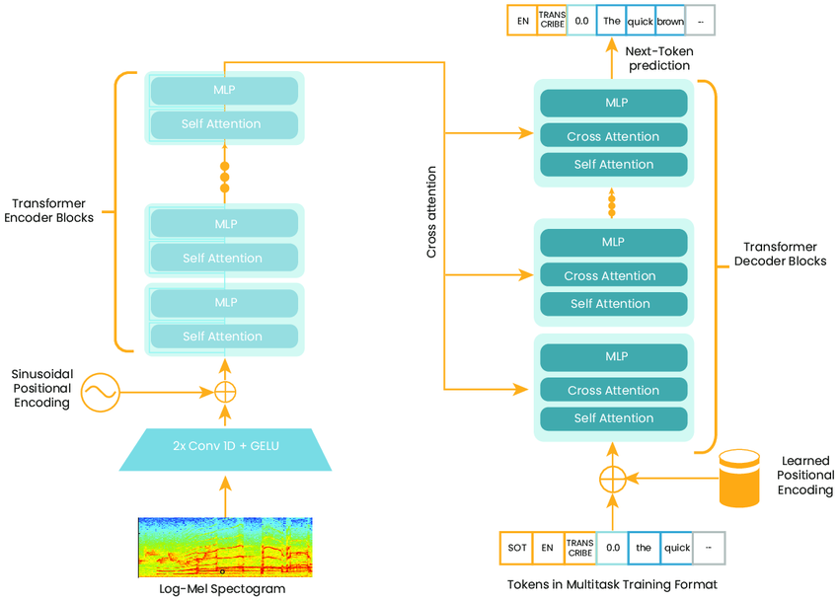
OPEN AI - WHISPER ARCHITECTURE

Slide 15
Breakdown of the architecture
Encoder: The audio input is first transformed into a log-mel spectrogram. This spectrogram is then fed into multiple encoder blocks. Each encoder block consists of two convolutional layers with GELU activation function.
Sinusoidal positional encoding: This encoding is added to the output of the encoder blocks to account for the order of words in a sentence .
Decoder: The decoder block takes the output of the encoder and the positional encoding as input. It uses a masked self-attention mechanism to focus on the relevant parts of the input sequence. The decoder also uses an attention mechanism to attend to the output of the encoder blocks.
Next-token prediction: The decoder predicts the next token in the output sequence one at a time. The final output layer of the decoder maps the decoder outputs to probabilities over the vocabulary.

Slide 16

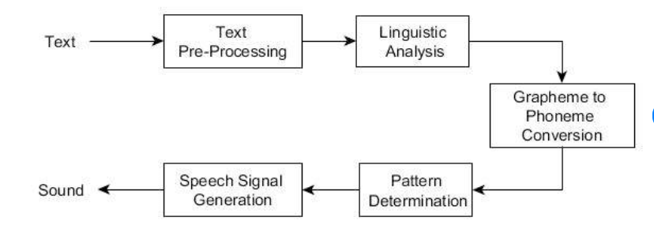
The gTTS (Google Text-to-Speech) library utilizes a deep neural network model trained on extensive speech data to convert input text into natural-sounding speech. Upon receiving input text, the library preprocesses it and extracts linguistic features, which are fed into the neural network.
The model then predicts acoustic parameters required for speech synthesis, including pitch, duration, and spectral features. These parameters are used to generate the final speech waveform, delivering high-quality audio output that closely resembles human speech patterns.

Slide 17
MODULES
Configuration and Setup: Configure and set up the required environment.
Image and Text Processing:Utilize Llava 1.5 7B for image-to-text processing.Process textual prompts and instructions.
Multimodal Model Integration:Integrate BitsAndBytes quantization for model efficiency.Use the Whisper model for accurate speech-to-text conversion.

Slide 18
Logging and History: Implement logging functionality to record user interactions and model responses.
Audio Processing and Output: Employ gTTS for text-to-speech conversion. Utilize FFmpeg for audio processing and output.
Quality Assurance and Testing: Implement testing procedures to ensure the reliability of the system.
User Interaction and Output:Create a Gradio interface for user-friendly interaction.Display the processed text output and generated speech.

Slide 19
APPLICATIONS
E-commerce: Users can verbally describe items they're interested in purchasing, and the voice assistant can analyze product images to provide recommendations, details, and pricing information.
Social Media: Users can ask the voice assistant to analyze images from their social media feeds, such as identifying objects, recognizing people, or detecting sentiments in images.
Healthcare: Healthcare professionals can use the voice assistant to analyze medical images, such as X-rays or MRIs, for diagnosis, anomaly detection, and treatment planning.
Education: Students can use the voice assistant to analyze educational images, such as diagrams or maps, for better understanding and learning reinforcement.
Travel: Travelers can describe landmarks or attractions they encounter during their trips, and the voice assistant can provide information, history, and nearby points of interest.
Art and Design: Artists and designers can use the voice assistant to analyze artworks, providing insights, critiques, and suggestions for improvement.
Fashion: Users can ask the voice assistant to analyze fashion images, identifying clothing items, styles, and trends, and providing recommendations for outfits.
Food and Nutrition: Users can describe food items they're interested in, and the voice assistant can analyze images to identify ingredients, and provide nutritional information.

Slide 20
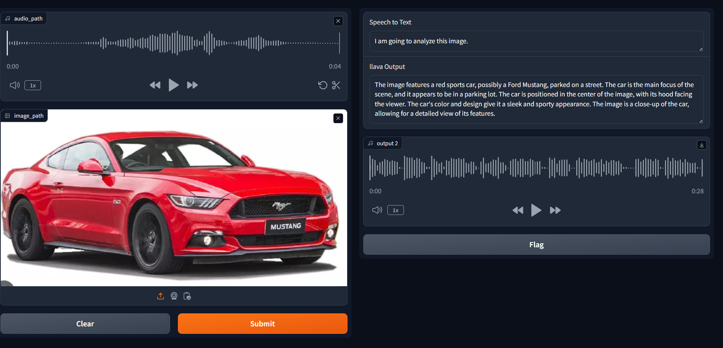

Slide 21
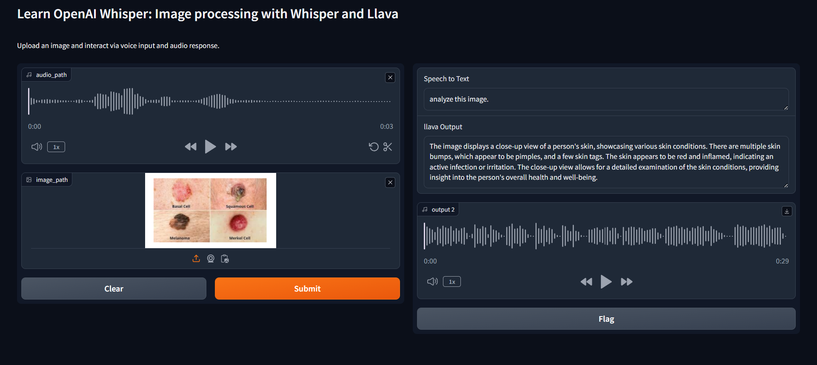

Slide 22
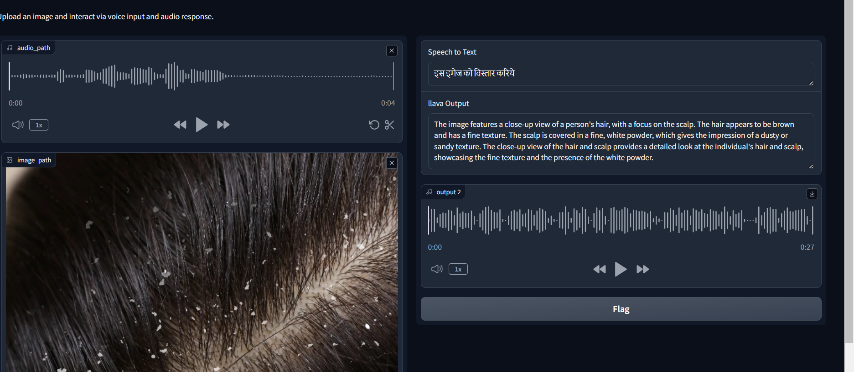

Slide 23
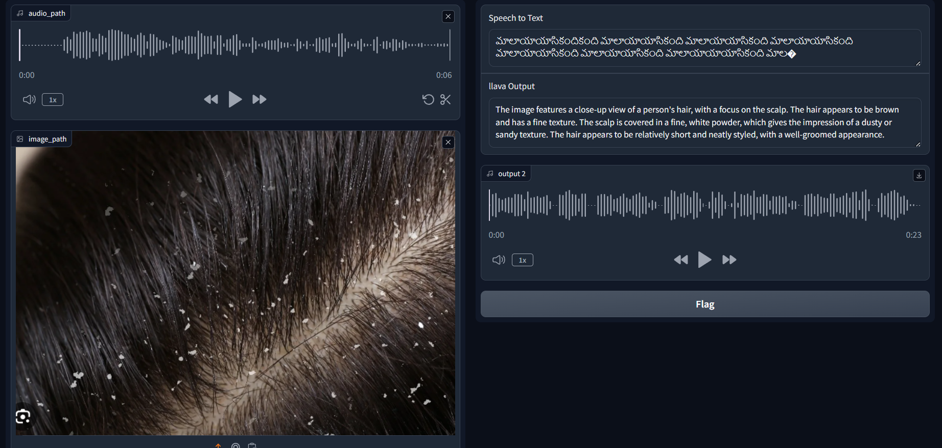

Slide 24
REFERENCES
Kelley, Steven. ”Seeing AI: Artificial intelligence for blind and visually impaired users.” (2018).
N. Lakhani, H. Lakhotiya and N. Mulla, ”Be My Eyes: An Aid for the Visually Impaired,” 2022 IEEE 3rd Global Conference for Advancement in Technology (GCAT), Bangalore, India, 2022, pp. 1-6, doi: 10.1109/GCAT55367.2022.9972160
Wu, Chenfei, Shengming Yin, Weizhen Qi, Xiaodong Wang, Zecheng Tang, and Nan Duan. ”Visual chatgpt: Talking, drawing and editing with visual foundation models.” arXiv preprint arXiv:2303.04671 (2023).
Liu, Haotian, Chunyuan Li, Qingyang Wu, and Yong Jae Lee. ”Visual instruction tuning.” arXiv preprint arXiv:2304.08485 (2023).
Stangl, Abigale, Meredith Ringel Morris, and Danna Gurari. ”Person, Shoes, Tree. Is the Person Naked?” What People with Vision Impairments Want in Image Descriptions.” Proceedings of the 2020 chi conference on human factors in computing systems. (2020)

